Slide 1
Pattern Recognition
Homework 2 Announcement
Lastest update: 2023.03.29 00:40
Notes:
‹#›

Slide 2
Homework 2
Deadline: Apr. 08, Sat. at 23:59
Code assignment (70%)
Implement Logistic Regression and Fisher’s Linear Discriminant using only NumPy.
Questions (30%)
Write your answer in detail in the report.
Question: Link
Sample code: Link
Dataset: Link

Slide 3
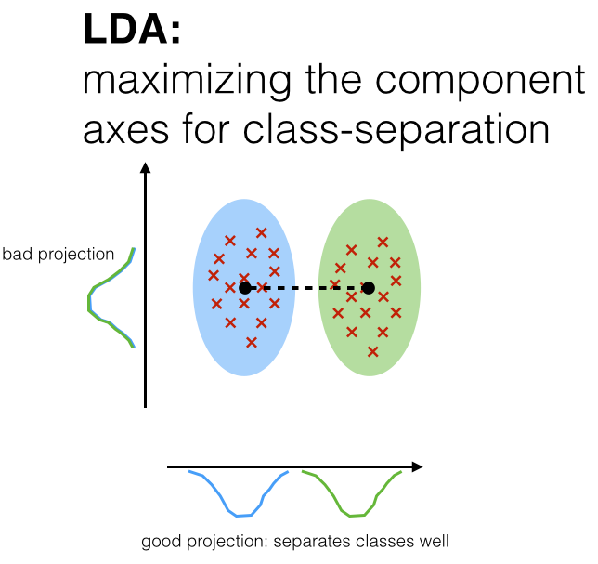
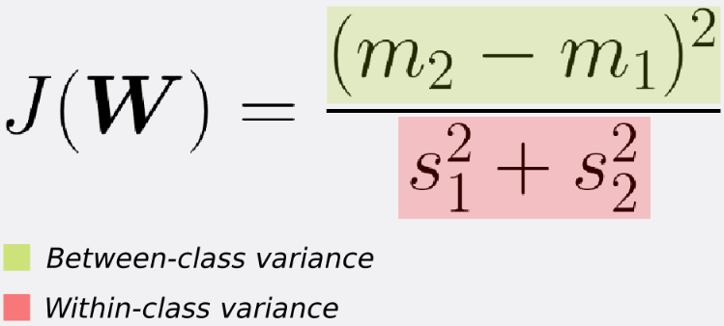
Fisher’s Linear Discriminant
FLD seeks the projection w that gives a large distance between the projected data means while giving a small variance within each class.
https://sebastianraschka.com/Articles/2014_python_lda.html, https://sthalles.github.io/fisher-linear-discriminant/

Slide 4
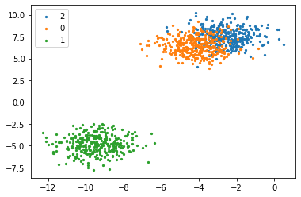

Blob Dataset (for Q1~Q12)
sklearn.datasets.make_blobs
2 features, 3 labels
Training set
Testing set (with label)
Train the models using the training set and evaluate using the testing set by yourself.

Slide 5
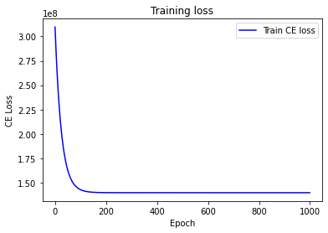
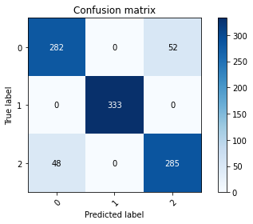
Logistic Regression Model - 20%
Like HW1, use only Numpy to implement the Logistic Regression.
Tune the parameters and use gradient descent methods to train your model.
Cross Entropy and Softmax.
Your model should get at least 0.88 accuracy score on testing set.
Plot the learning curve and the confusion matrix.
For your reference

Slide 6
Fisher’s Linear Discriminant (FLD) Model - 30%
Use only Numpy to implement the FLD.
Show the following results:
Mean vectors m_{i}
Within-class scatter matrix s_{W}
Between-class scatter matrix s_{B}
Fisher’s linear discriminant w

Slide 7
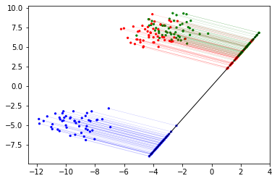
Fisher’s Linear Discriminant (FLD) Model - 30%
Predict the testing data.
Determined by the shortest distances to the class mean.
Determined by KNN (k=1, 2, 3, 4, 5) (Refer to chapter 3 slide, page 30)
Analyze the performance between the two methods and also the different values of k.

Slide 8
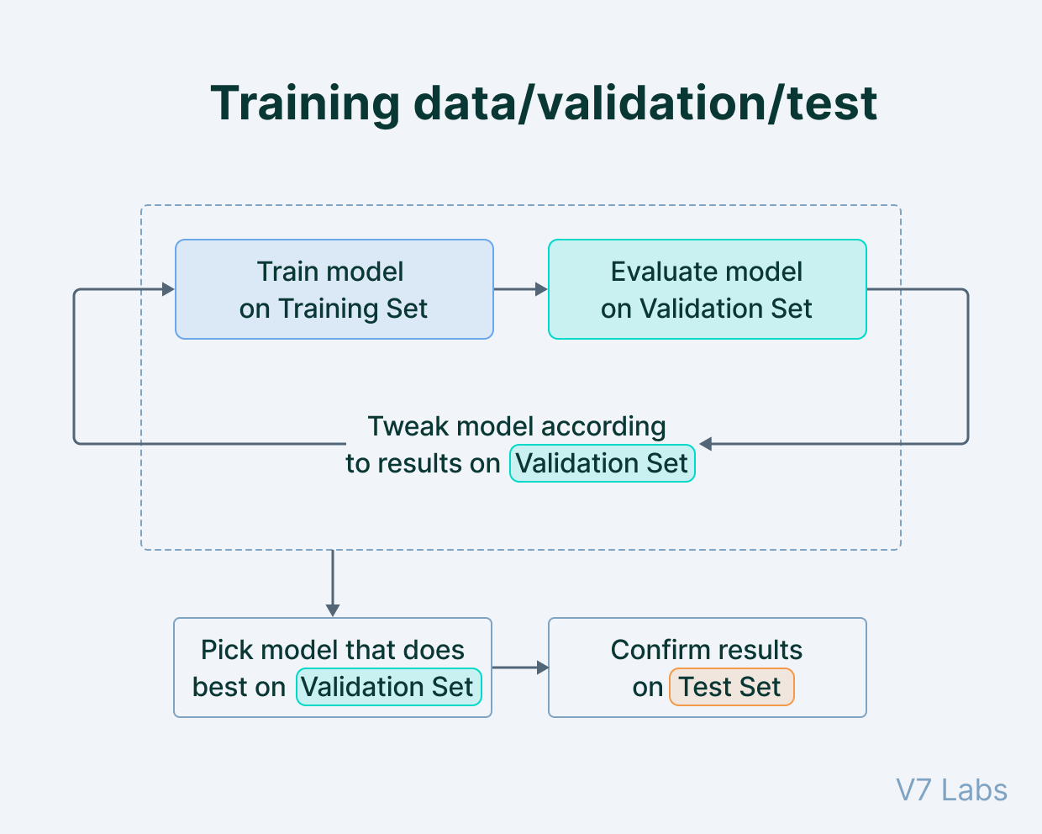
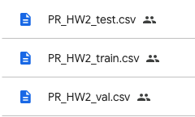
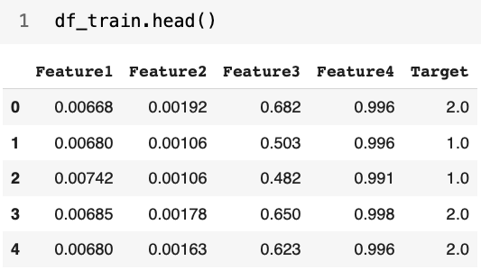
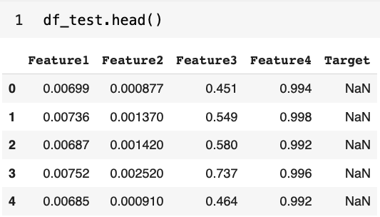
Train your own model (20%)
A real word dataset
training set
validation set
testing set
4 features, 3 labels
Imbalanced data
https://www.v7labs.com/blog/train-validation-test-set

Slide 9
Train your own model (20%)
You can only use the FLD/Logistic Regression that you implemented.
You can try different learning rates, epochs, batch-size, and features to beat the baseline.
Explain in detail how you choose the model, parameters, and features in the report. Otherwise, extra penalty.
Some hints in HW1 may still be helpful in HW2.
Predict the testing data and save the result into a CSV file.

Slide 10
Train your own model (20%)
Evaluation is based on testing accuracy.
Testing data distribution is guaranteed to be similar to validation data.
Point | Testing Accuracy
20 | testing acc > 0.921
15 | 0.91 < testing acc <= 0.921
8 | 0.9 <= testing acc <= 0.91
0 | testing acc <= 0.9

Slide 11
Report
Please write your report in English.
Please follow the HW1 report template.
You must type the answer and also screenshot at the same time for the coding part.
Answer each question as clearly as possible. You will get an extra penalty for only the brief answer.

Slide 12
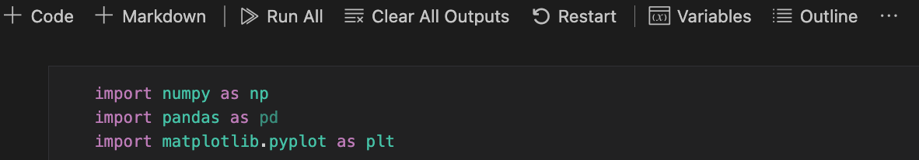
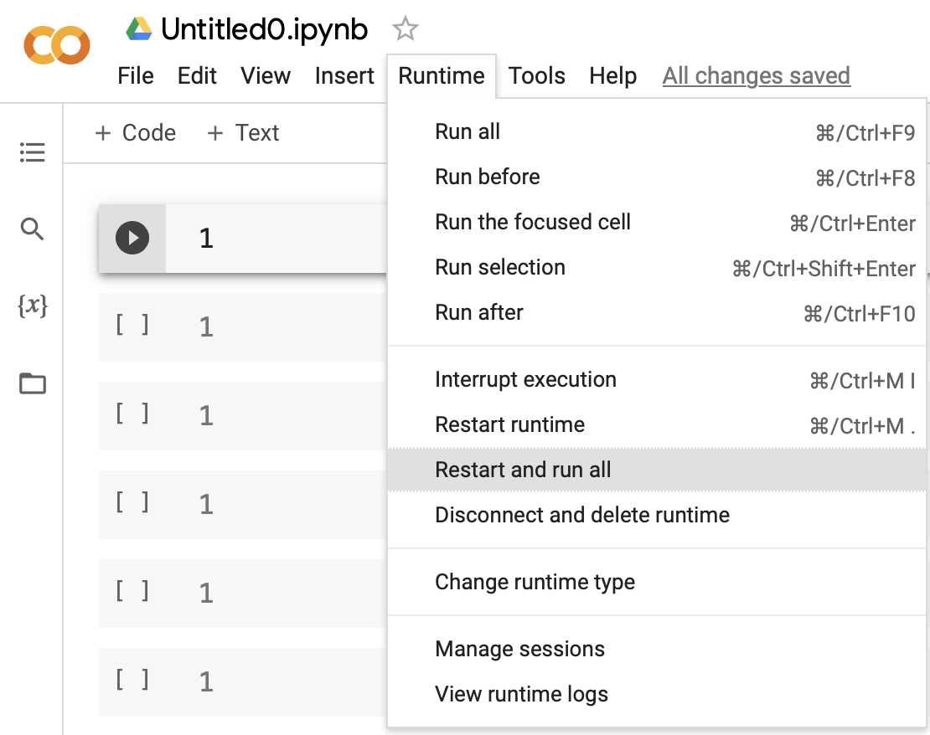
Submission
Compress your .ipynb, .pdf, and .csv into a zip file and submit it on E3.
Before submission:
Restart and run All
Save and submit the .ipynb (keep all cell outputs)
Get 0 points if you do not keep the cell outputs.
<STUDENT ID>_HW2.zip
<STUDENT ID>_HW2.ipynb
<STUDENT ID>_HW2.pdf
<STUDENT ID>_prediction.csv
For your reference

Slide 13
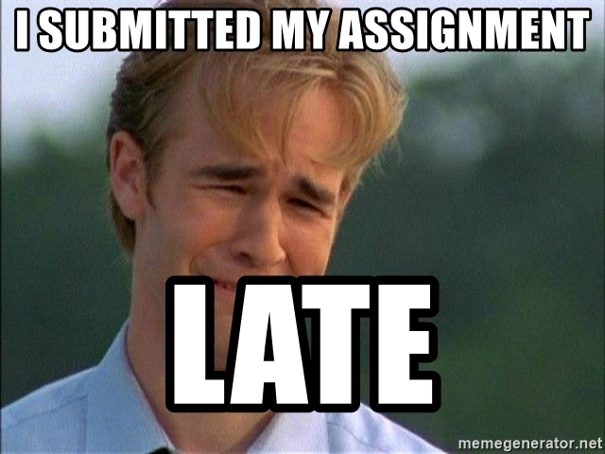
Late policy
We will deduct a late penalty of 20 points per additional late day.
For example, If you get 90 points but delay for two days, you will get only 90- (20 x 2) = 50 points!

